Slide 1
Using Direct Memory Access to Improve Performance

Slide 2
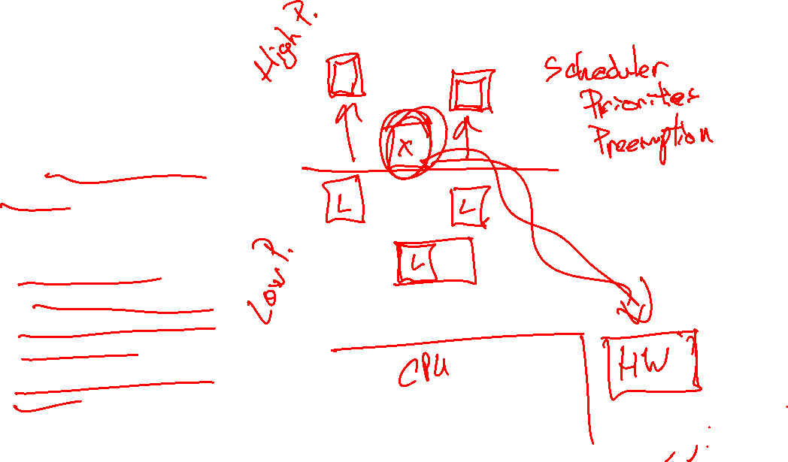
Motivation
Performance improvements of moving work from software to hardware
Speed: hardware faster than software
Timing predictability:
Makes less of system vulnerable to timing interference by software
Reduces interference for other software
Makes design and analysis easier

Slide 3
Overview
Basic Concepts
DMA Peripherals in Cortex-M0+
DMA Applications
Data Transfer
Replacing ISRs

Slide 4
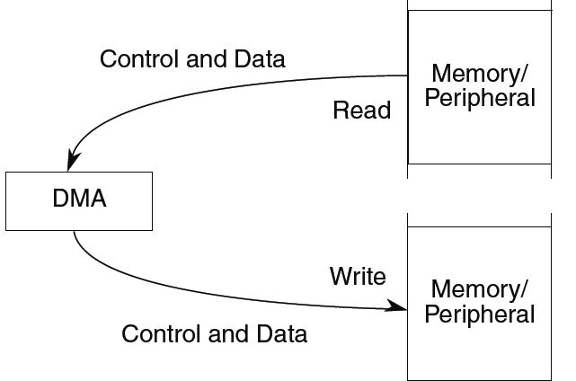
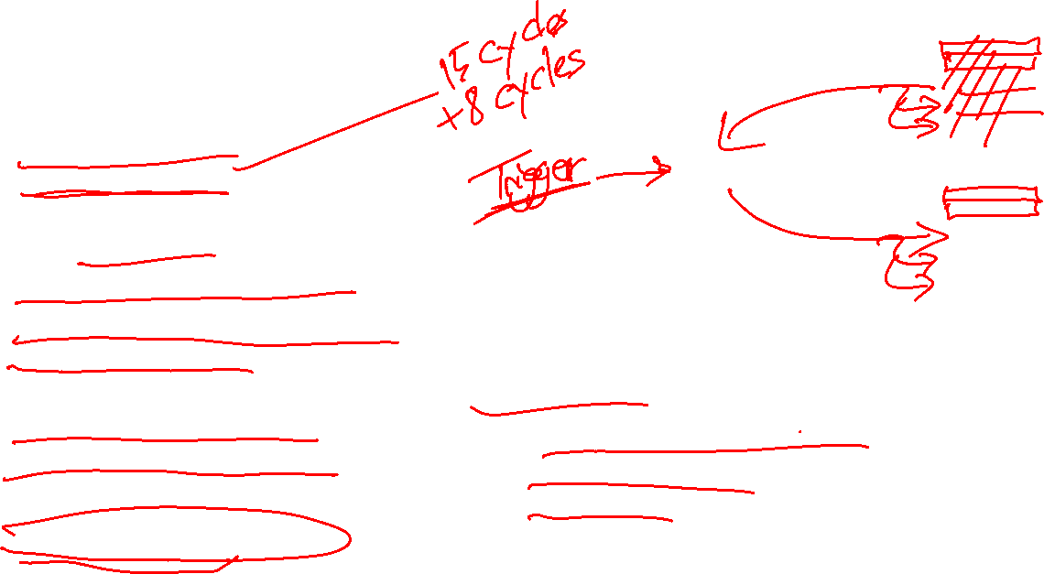
Basic Concepts
Hardware which reads data from a source and writes it to a destination
Can copy data quickly
Can eliminate ISRs which just copy data (e.g. move ADC results into buffer)
Example: Data copy
Source: source memory buffer
Destination: destination memory buffer
Trigger: software command
Various configurable options
Number of data items to copy
Source and destination addresses can be fixed or change (e.g. increment, decrement)
Size of data item (1, 2, 4 bytes)
When transfer starts
Operation
Initialization: Configure controller
Transfer: Data is copied
Termination: Channel indicates transfer has completed

Slide 5
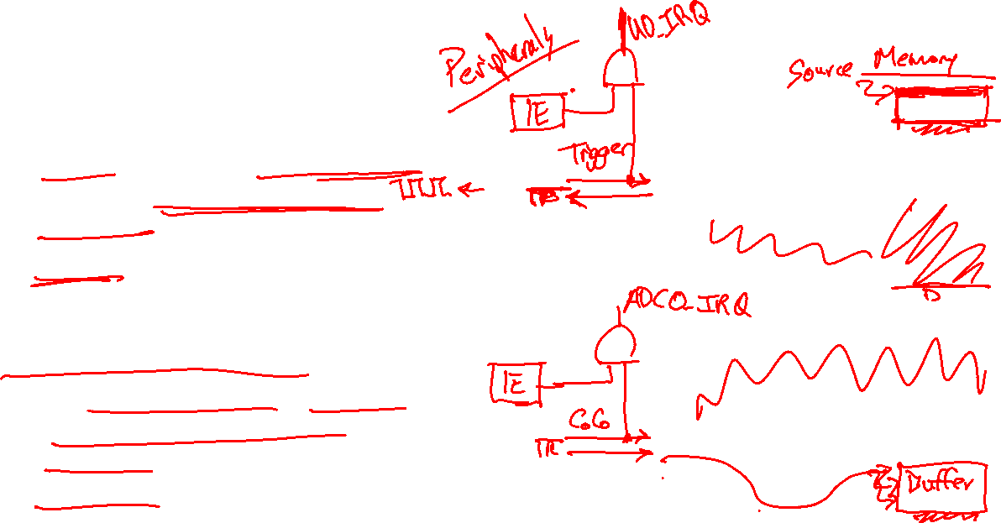
More DMA Examples
Transmit data through UART
Source: Memory buffer, address increments
Destination: UART Transmit data buffer, address fixed
Trigger: UART Transmit Complete
Save ADC samples in buffer
Source: ADC result register, address fixed
Destination: Memory buffer, address increments
Trigger: ADC Conversion Complete
UART
ADC

Slide 6
DMA and MCU Bus Architecture
ARM® Cortex®-M0+ Core
Memories
High-Speed System Bus
Communications
HMI
DMA Controller
I²C
Flex IO
Bridge
GPIO
Ch 0
Ch 1
Ch 2
Ch 3
SPI
USB OTG
Touch-Sensing
UART
I²S
Peripheral Bus
Analog
Timers
Analog Comparator
PWM
12-bit DAC
Low-Power Timer
16-bit DAC
Periodic Interrupt Timers
Internal Voltage Reference
Real-Time Clock

Slide 7
DMA Controller Features
4 independent channels
Channel 0 has highest priority
8-, 16- or 32-bit transfers, data size can differ between source and destination
Modulo addressability
Pointer wraps around at end of buffer
Enables ring buffers with size of 2^{N}
Can trigger with hardware signal or software
How many data items are transferred per trigger?
One: “Cycle stealing”
All items: grabs bus
Hardware acknowledge/done signal

Slide 8
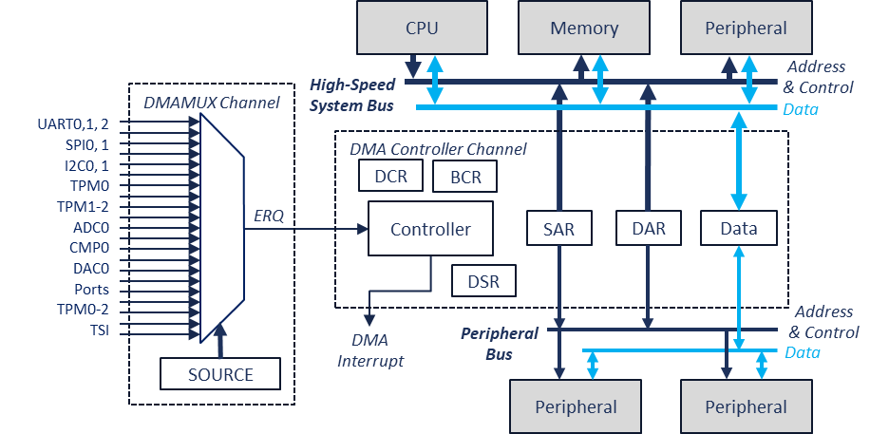
DMA Controller Details

Slide 9
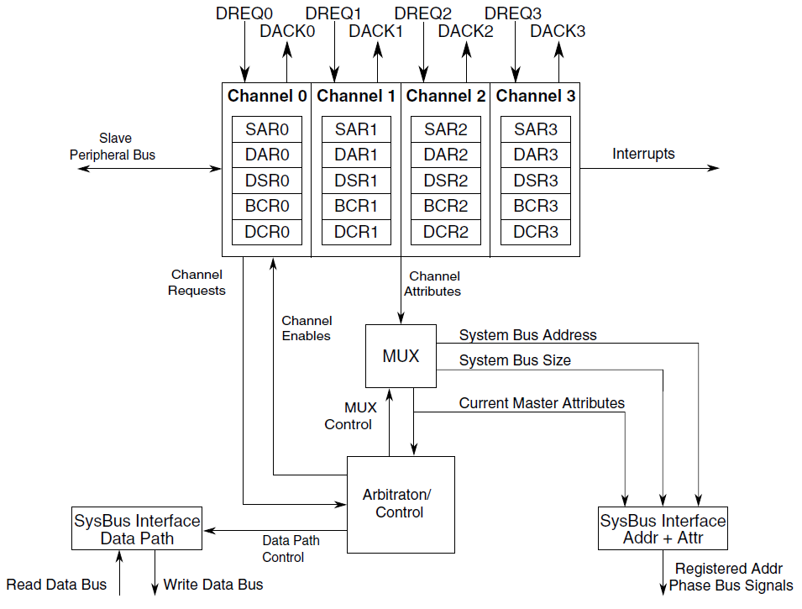
DMA Controller
Notes:
The DMA controller contains four channels. Each channel has various control and status registers (SAR, DAR, DSR, BCR, DCR). When a channel wants to perform a transfer it needs to arbitrate with other devices on the system bus to get permission. Once it gets permission, it is able to perform one or more transfer operations on the system bus.

Slide 10
Address Registers
These registers determine from where the DMA will read its data, and to where it will write that data
DMA_SARn
Source address register,
Valid values 0 to 0x000f ffff
DMA_DARn
Destination address register
Valid values 0 to 0x000f ffff

Slide 11
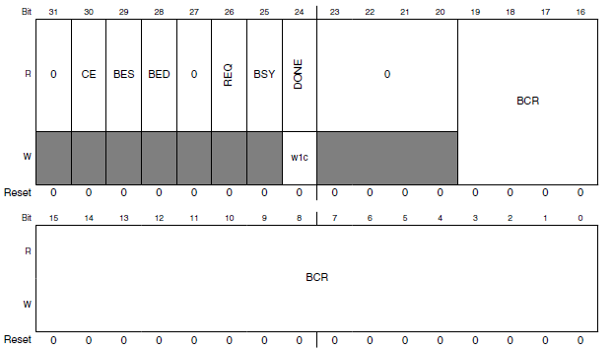
Byte Count Register
BCR: Bytes remaining to transfer
Decremented by 1, 2 or 4 after completing write (determined by destination data size)

Slide 12
Status Register/Byte Count Register DMA_DSR_BCRn
Status flags: 1 indicates error
CE: Configuration error
BES: Bus error on source
BED: Bus error on destination
REQ: A transfer request is pending (more transfers to perform)
BSY: DMA channel is busy
DONE: Channel transfers have completed or an error occurred. Clear this bit in an ISR.

Slide 13
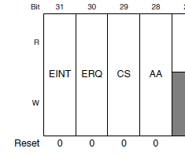
DMA Control Register (DMA_DCRn)
EINT: Enable interrupt on transfer completion
ERQ: Enable peripheral request to start transfer
CS: Cycle steal
0: Greedy - DMA makes continuous transfers until BCR == 0
1: DMA shares bus, performs only one transfer per request
AA: Autoalign

Slide 14
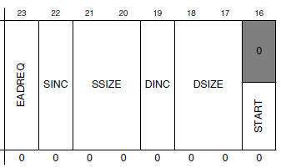
DMA Control Register (DMA_DCRn)
EADRQ – Enable asynchronous DMA requests when MCU is in Stop mode
SINC/DINC – Increment SAR/DAR by 1,2 or 4 based on size of data
SSIZE/DSIZE – Source/Destination data size.
Don’t need to match – controller will perform extra reads or writes as needed (e.g. read one word, write two bytes).
00: longword (32 bits)
01: byte (8 bits)
10: word (16 bits)
START – Write 1 to start transfer

Slide 15
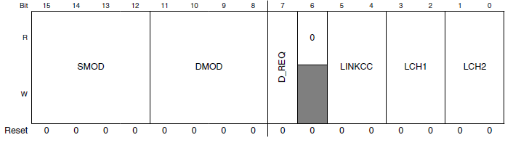
DMA Control Register (DMA_DCRn)
SMOD, DMOD – Source/Destination address modulo
When non-zero, supports circular data buffer – address wraps around after 2^{n+3} bytes (16 bytes to 64 kilobytes)
When zero, circular buffer is disabled
D_REQ: If 1, then when BCR reaches zero, channel will clear ERQ bit, preventing further hardware triggers of channel
LINKCC: Enables this channel to trigger another channel
00: Disabled
01: Two stages:
Link to channel LCH1 after each cycle-steal transfer
Link to channel LCH2 after BCR reaches 0
10: Link to channel LCH1 after each cycle-steal transfer
11: Link to channel LCH1 after BCR reaches 0
LCH1, LCH2: Values 00 to 11 specify linked DMA channel (0 to 3)

Slide 16
Basic Use of DMA
Configuration
Enable clock to DMA module (in SIM register SCGC7)
Initialize control registers
Load SARn with source address
Load DARn with destination address
Load BCRn with number of bytes to transfer
Clear DSRn[DONE]
Transfer starts
If ERQ is 1, hardware signal is asserted
Or software sets DCRn[START]
Wait for end of transfer
Interrupt generated if DCRn[EINT] is set (DMAn_IRQHandler)
Or else poll DSRn[DONE]

Slide 17
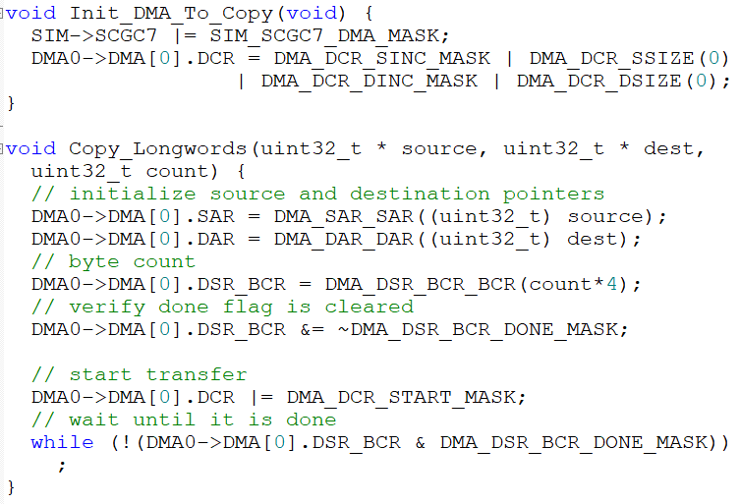
Demonstration: Memory Copy
Software-triggered
Could use as a fast version of memcpy function, but need to handle all cases
Alignment of source and destination
Detecting overlapping buffers
Data size

Slide 18
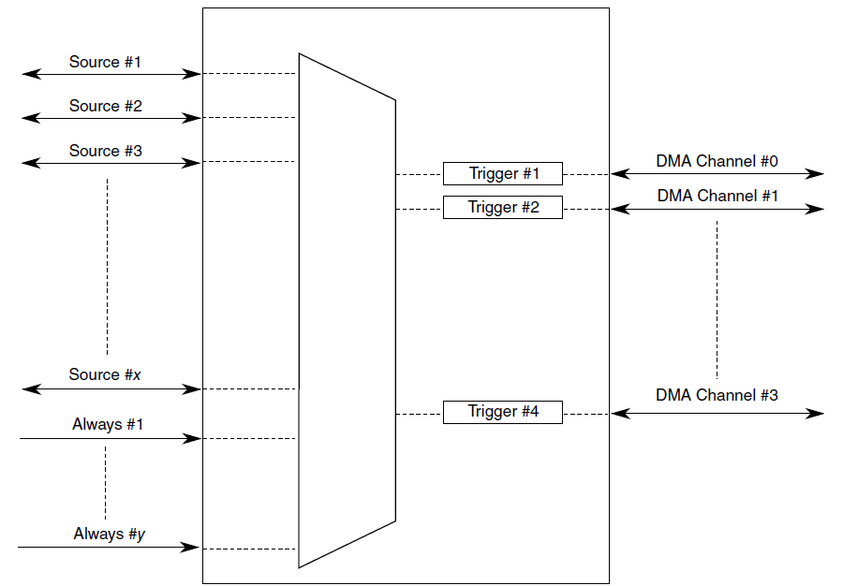

Triggering DMA Activity Using Peripherals
Can use trigger events from peripherals to start DMA transfer
Upon triggering, DMA can perform:
One transfer (cycle steal mode)
All transfers until BCR == 0 (continuous mode)
DMA Multiplexer (DMAMUX)
Selects which source will trigger a DMA channel
Each DMA channel n has a configuration register DMAMUX_CHCFGn
ENBL: Enable DMA channel
TRIG: Enables triggering of DMA channel
SOURCE: Selects triggering source
Notes:
This is helpful because it eliminates an ISR, resulting in better system performance and less CPU loading.

Slide 19
Trigger Sources
A variety of peripherals can trigger DMA activity
Trigger sources are chip-specific, so see KL25 Sub-Family Reference Manual (rev. 1), Chapter 3 - Chip Configuration, Section 3.4.8.1 DMA MUX Request Sources
Source # | Module | Description
0 | - | Disabled
2-7 | UART0,1, 2 | Receive, Transmit
16-19 | SPI0, 1 | Receive, Transmit
22-23 | I²C0, 1
24-29 | TPM0 | Channels 0-5
32-35 | TPM1-2 | Channels 0-1
40 | ADC0
42 | CMP0
45 | DAC0
49-53 | Port Control Module | Port A-E
54-56 | TPM0-2 | Overflow
57 | TSI
60-63 | DMAMUX | Always enabled

Slide 20
Triggering DMA Transfers with PITs
DMA Channels 0, 1 can be triggered by PITs 0 and 1 as well as the previously listed sources
PIT generates a trigger pulse each time it reaches 0
Disable interrupt for PITn by clearing TIE (interrupt enable) bit.
Clear ENBL and TRIG bits in CHCFGn register
Configure DMA Controller channel
Configure timer
Select trigger source with CHCFGn register and set ENBL and TRIG bits

Slide 21
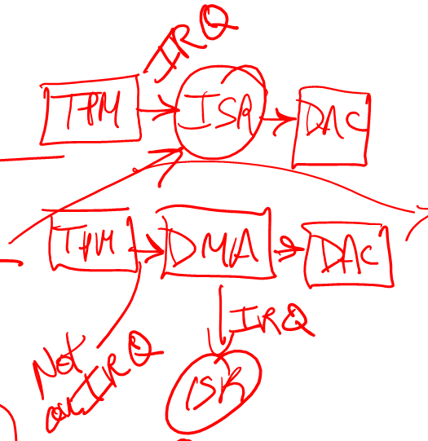
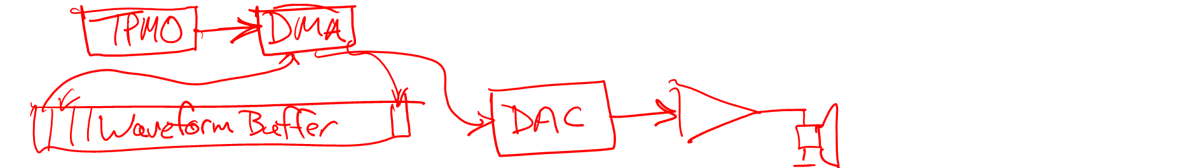
DAC Waveform Playback Example
Timer overflow ISR updates DAC
Timer overflow triggers DMA transfer to DAC

Slide 22

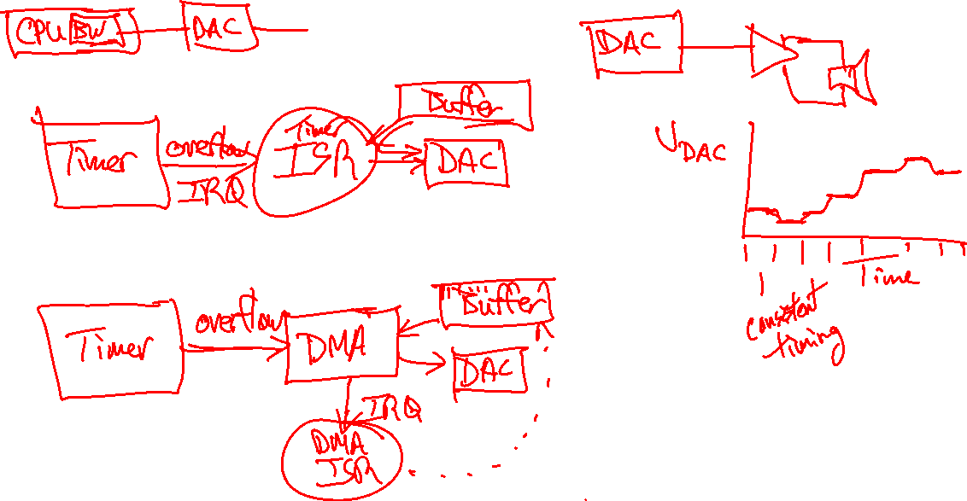
DAC Waveform Playback Example
Timer overflow ISR updates DAC
Timer overflow triggers DMA transfer to DAC

Slide 23
Configuration Details for DAC Playback
TPM0 expires when DAC update is needed
TPM Configuration
Don’t enable timer interrupt
TPM will still generate trigger event
When DMA is triggered by TPM:
Copy one 16-bit data element from wave table (source) to DAC data register (DAC0->DAT[0])
Increment source address, decrement byte count
When DMA finishes last transfer
Generate interrupt
IRQ handler will clear interrupt flags, restart DMA transfers
DMA Configuration
Source, destination sizes = 2 bytes: SSIZE = DSIZE = 2
Enable peripheral request: ERQ = 1
Select hardware trigger
One transfer per peripheral request, so use cycle-steal mode: CS = 1
# Bytes to transfer: BCR = 2 bytes * # of samples
Increment source register: SINC = 1
Do not increment destination register: DINC = 0

Slide 24
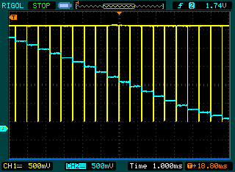
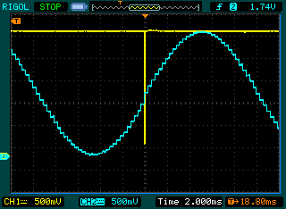
Performance Comparison
Traces
Yellow: ISR is executing when trace is low
Blue: DAC output (PTE30, pin 11 of J10)
Without DMA: Interrupt per sample
4.7 microseconds per 620 microseconds
0.758% of processor’s time
With DMA: Interrupt per cycle
5.0 microseconds per 20 milliseconds
0.025% of processor’s time
How is this useful?
Saves CPU time
Reduces timing vulnerability to interrupts being disabled
Enables CPU to sleep longer, wake up less often (20 milliseconds vs. 620 microseconds)

